Slide 1

Route Finding
Amber Jones & Dave Touretzky

Slide 2
Two Ways to Solve Route-Finding Problems
Graph coloring
Search tree
Both approaches use the same
algorithm: breadth-first search.
But they use different representations (Big Idea 2): pre-constructed graph
vs. dynamically grown tree.
Toccoa
Rome
Athens
Atlanta
Newnan
Augusta
Milledgeville
LaGrange
Macon
Columbus
Statesboro
Warner Robins
McRae
Savannah
Albany
Hinesville
Tifton
Waycross
Brunswick
Bainbridge
Valdosta

Slide 3
Breadth-First Search (Using Colors)
Toccoa
Rome
Athens
Atlanta
Augusta
Color the starting city as level 0.
Find all the uncolored neighbors, and
color them using the next level’s color.
Repeat step 2 until you’ve colored
the destination city.
Newnan
Milledgeville
LaGrange
Macon
Columbus
Statesboro
Warner Robins
McRae
Savannah
Albany
Hinesville
Tifton
Waycross
Brunswick
Level 0
Level 1
Level 2
Level 3
Level 4
Bainbridge
Valdosta

Slide 4
How to get from Savannah to Valdosta: Level 0
Toccoa
Color our start city:
Savannah is level 0.
Rome
Athens
Level 0
Atlanta
Newnan
Augusta
Milledgeville
LaGrange
Macon
Columbus
Statesboro
Warner Robins
McRae
Savannah
Albany
Hinesville
Tifton
Waycross
Brunswick
Bainbridge
Valdosta
Which cities will be cities?
Level 1

Slide 5
How to get from Savannah to Valdosta: Level 1
Toccoa
Color the cities reachable from Savannah as level 1.
Rome
Athens
Level 0
Atlanta
Augusta
Level 1
Newnan
Milledgeville
LaGrange
Macon
Columbus
Statesboro
Warner Robins
McRae
Savannah
Albany
Hinesville
Tifton
Waycross
Brunswick
Bainbridge
Valdosta
Which cities will be cities?
Level 2

Slide 6
How to get from Savannah to Valdosta: Level 2
Toccoa
Color the uncolored neighbors of level 1 cities as level 2.
Rome
Athens
Level 0
Atlanta
Augusta
Level 1
Newnan
Milledgeville
LaGrange
Level 2
Macon
Columbus
Statesboro
Warner Robins
McRae
Savannah
Albany
Hinesville
Tifton
Waycross
Brunswick
Bainbridge
Valdosta
Which cities will be cities?
Level 3

Slide 7
How to get from Savannah to Valdosta: Level 3
Toccoa
Color the uncolored neighbors of level 2 cities as level 3.
Rome
Athens
Level 0
Atlanta
Augusta
Level 1
Newnan
Milledgeville
LaGrange
Level 2
Macon
Columbus
Statesboro
Level 3
Warner Robins
McRae
Savannah
Albany
Hinesville
Tifton
Waycross
Brunswick
Bainbridge
Valdosta
Which cities will be cities?
Level 4

Slide 8
How to get from Savannah to Valdosta: Level 4
Toccoa
Color the uncolored neighbors of level 3 cities as level 4.
This includes our destination city, Valdosta.
Yay!
Rome
Athens
Level 0
Atlanta
Augusta
Level 1
Newnan
Milledgeville
LaGrange
Level 2
Macon
Columbus
Statesboro
Level 3
Warner Robins
McRae
Savannah
Level 4
Albany
Hinesville
Tifton
Waycross
Brunswick
Bainbridge
Valdosta
There are still some cities left uncolored. Do we need to go to level 5?

Slide 9
Recovering the solution path
Toccoa
Begin at the
destination (Valdosta) and work backwards
toward the start (Savannah).
Then reverse the result.
Rome
Level 0
Athens
Level 0
Atlanta
Level 1
Augusta
Level 1
Newnan
Milledgeville
Level 2
LaGrange
Level 2
Macon
Statesboro
Level 3
Columbus
Level 3
Warner Robins
McRae
Savannah
Level 4
Level 4
Albany
Hinesville
Tifton
Waycross
Brunswick
Bainbridge
Valdosta

Slide 10
What Errors Do Students Make?
Missing some of the uncolored neighbors of a node.
Coloring a node that has already been colored.
Continuing to color nodes after the target node has been reached.

Slide 11
Now we will use our worksheets to find the route from
Columbus to Hinesville

Slide 12
You Try It: Columbus to Hinesville
Toccoa
Color our start city:
Columbus is level 0.
Rome
Athens
Level 0
Atlanta
Newnan
Augusta
Milledgeville
LaGrange
Macon
Columbus
Statesboro
Warner Robins
McRae
Savannah
Albany
Hinesville
Tifton
Waycross
Brunswick
Bainbridge
Valdosta
Which cities will be cities?
Level 1

Slide 13
You Try It: Columbus to Hinesville
Toccoa
Color the cities reachable from Columbus as level 1.
Rome
Athens
Level 0
Atlanta
Augusta
Level 1
Newnan
Milledgeville
LaGrange
Macon
Columbus
Statesboro
Warner Robins
McRae
Savannah
Albany
Hinesville
Tifton
Waycross
Brunswick
Bainbridge
Valdosta
Which cities will be cities?
Level 2

Slide 14
You Try It: Columbus to Hinesville
Toccoa
Color the uncolored neighbors of level 1 cities as level 2.
Rome
Athens
Level 0
Atlanta
Augusta
Level 1
Newnan
Milledgeville
LaGrange
Level 2
Macon
Columbus
Statesboro
Warner Robins
McRae
Savannah
Albany
Hinesville
Tifton
Waycross
Brunswick
Bainbridge
Valdosta
Which cities will be cities?
Level 3

Slide 15
You Try It: Columbus to Hinesville
Toccoa
Color the uncolored neighbors of level 2 cities as level 3.
Rome
Athens
Level 0
Atlanta
Augusta
Level 1
Newnan
Milledgeville
LaGrange
Level 2
Macon
Columbus
Statesboro
Level 3
Warner Robins
McRae
Savannah
Albany
Hinesville
Tifton
Waycross
Brunswick
Bainbridge
Valdosta

Slide 16
Solution: Columbus to Hinesville
Toccoa
Now recover the solution path by tracing backward from Hinesville.
Rome
Athens
Level 0
Atlanta
Augusta
Level 1
Newnan
Milledgeville
LaGrange
Level 2
Macon
Columbus
Statesboro
Level 3
Warner Robins
McRae
Savannah
Albany
Hinesville
Tifton
Waycross
Brunswick
Bainbridge
Valdosta

Slide 17
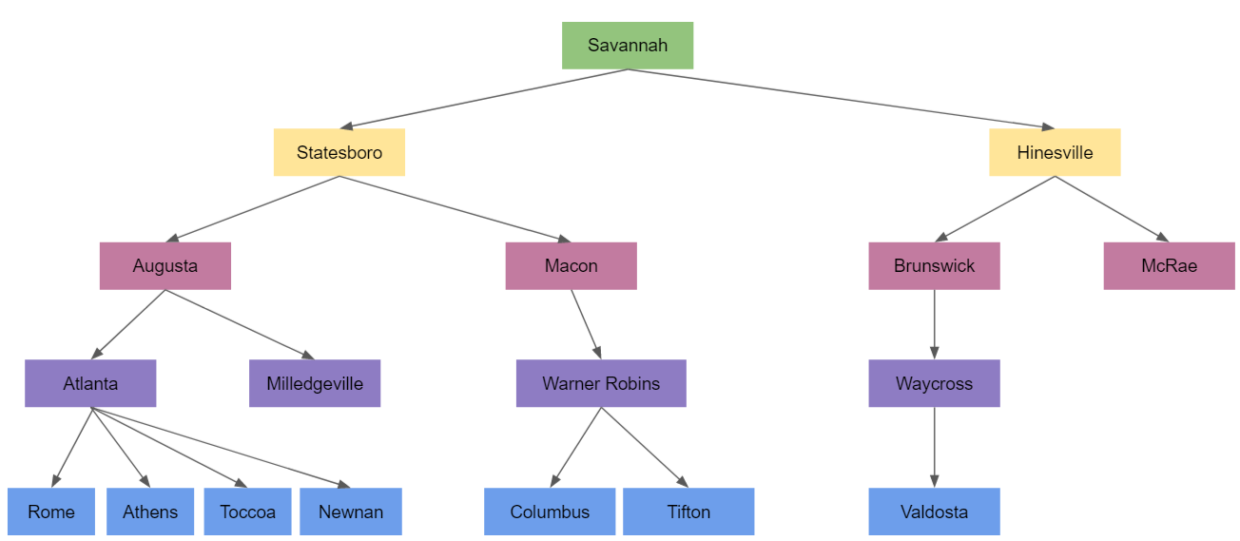
Breadth-First Search: Search Tree
Fun Fact: Breadth-first search can be used even when we don’t have a graph to color.
The algorithms works by constructing a search tree. This tree finds a route from Savannah to Valdosta.

Slide 18
Tree Terminology
root
node
parent
link
child
leaves

Slide 19
Let’s draw a search tree to find a route from Savannah to Valdosta
Toccoa
Let’s locate on the map
Savannah
Valdosta
Rome
Athens
Atlanta
Newnan
Augusta
Milledgeville
LaGrange
Macon
Columbus
Statesboro
Warner Robins
McRae
Savannah
Albany
Hinesville
Tifton
Waycross
Brunswick
Bainbridge
Valdosta
Notes:
Some interesting things to note about the “Atlanta to Warner Robins” problem. Atlanta has roads going off in all directions, so it emphasizes the fact that the algorithm has no idea which way to proceed; it has to try all possible paths. Also note that both Athens and Toccoa are directly reachable from Atlanta, so they will end up with the same color; the fact that there is a road from Athens to Toccoa doesn’t matter because Toccoa has already been colored by the time we start looking at Athens’ neighbors.

Slide 20
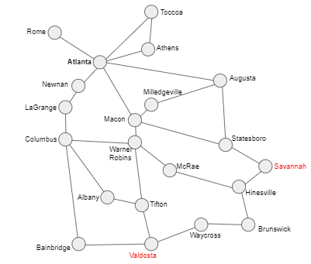
Breadth-First Search: Savannah to Valdosta
Step 1:
Make the starting city the root of the search tree (level 0).
Tree Root
Savannah

Slide 21
Breadth-First Search: Savannah to Valdosta
Current level
Step 2: For every node at the current level:
  Find its neighbors that are not already in the tree.
  Add those neighbors to the next level of the tree.
  If one of the neighbors is the destination, exit.
What cities neighbor Savannah?
Savannah

Slide 22
Breadth-First Search: Savannah to Valdosta
Current level
Savannah
Statesboro
Hinesville
Step 2: For every node at the current level:
  Find its neighbors that are not already in the tree.
  Add those neighbors to the next level of the tree.
  If one of the neighbors is the destination, exit.
Are we at our destination?

Slide 23
Breadth-First Search: Savannah to Valdosta
Savannah
Statesboro
Hinesville
Step 3: For every node at the current level:
  Find its neighbors that are not already in the tree.
  Add those neighbors to the next level of the tree.
  If one of the neighbors is the destination, exit.

Slide 24
Breadth-First Search: Savannah to Valdosta
Savannah
Statesboro
Hinesville
Augusta
Macon
Brunswick
McRae
What should we do next?
(Repeat the process again.)
Are we at our destination?

Slide 25
Breadth-First Search: Savannah to Valdosta
Savannah
Statesboro
Hinesville
Augusta
Macon
Brunswick
McRae
Atlanta
Milledgeville
Warner Robins
Waycross
Are we at our destination?

Slide 26
Breadth-First Search: Savannah to Valdosta
Savannah
Statesboro
Hinesville
Augusta
Macon
Brunswick
McRae
Atlanta
Milledgeville
Warner Robins
Waycross
Rome
Athens
Toccoa
Newnan
Columbus
Tifton
Valdosta
Are we at our destination?

Slide 27
Breadth-First Search: Savannah to Valdosta
Recovering the Solution Path
Savannah
Statesboro
Hinesville
Augusta
Macon
Brunswick
McRae
Atlanta
Milledgeville
Warner Robins
Waycross
Rome
Athens
Toccoa
Newnan
Columbus
Tifton
Valdosta

Slide 28
You Try It: Find A Route from Athens to Milledgeville
Toccoa
Use a blank sheet
of paper to
draw your tree.
Rome
Athens
Atlanta
Newnan
Augusta
Milledgeville
LaGrange
Macon
Columbus
Statesboro
Warner Robins
McRae
Savannah
Albany
Hinesville
Tifton
Waycross
Brunswick
Bainbridge
Valdosta

Slide 29
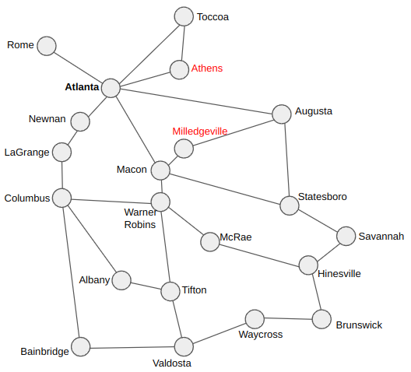
Breadth-First Search: Athens to Milledgeville
Athens
Are we at our destination?

Slide 30
Breadth-First Search: Athens to Milledgeville
Athens
Atlanta
Tocoa
Are we at our destination?

Slide 31
Breadth-First Search: Athens to Milledgeville
Athens
Atlanta
Tocoa
Rome
Newnan
Macon
Augusta
Are we at our destination?

Slide 32
Breadth-First Search: Athens to Milledgeville
Athens
Atlanta
Tocoa
Rome
Newnan
Macon
Augusta
LaGrange
Warner Robins
Statesboro
Milledgeville
Are we at our destination?

Slide 33
Common Questions
Why is it important to teach the tree search method?
  We may not have a graph available. For example, searching for moves when playing a game such as chess or tic-tac-toe, there is no pre-built graph, but we can still draw a tree.
Why is the algorithm called “breadth-first” search?
  Because at each step we add all the neighbors of all the nodes at the current level, making the tree as broad as possible before we make it deeper.
Are there other search algorithms we could use instead?
  Yes! There is depth-first search, best-first search, and several others. But breadth-first search is the simplest to explain.

